Slide 1
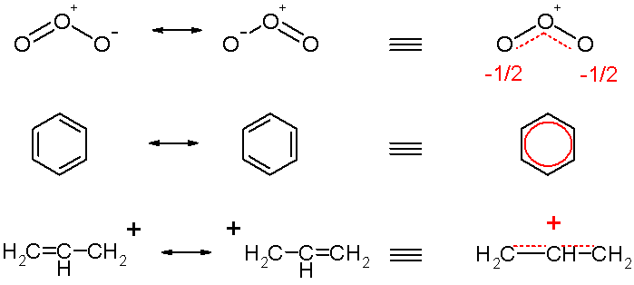
Chemical Resonance Modelling
Johan Rosqvist
Image sourced from Wikimedia Commons

Slide 2
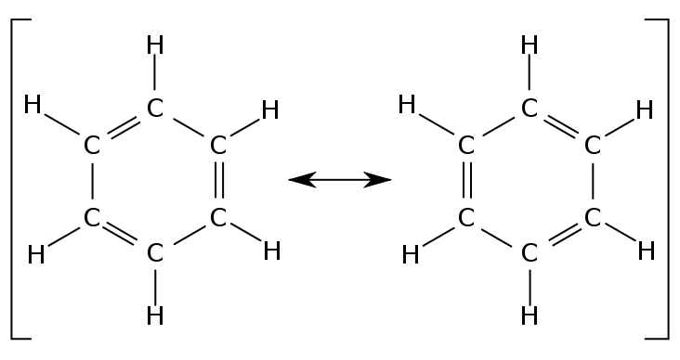
Resonant Structures
Molecules may have resonant structures
Bonds
Sigma (σ)
Pi (π)
Resonance Hybrid
Image sourced from Wikimedia Commons

Slide 3
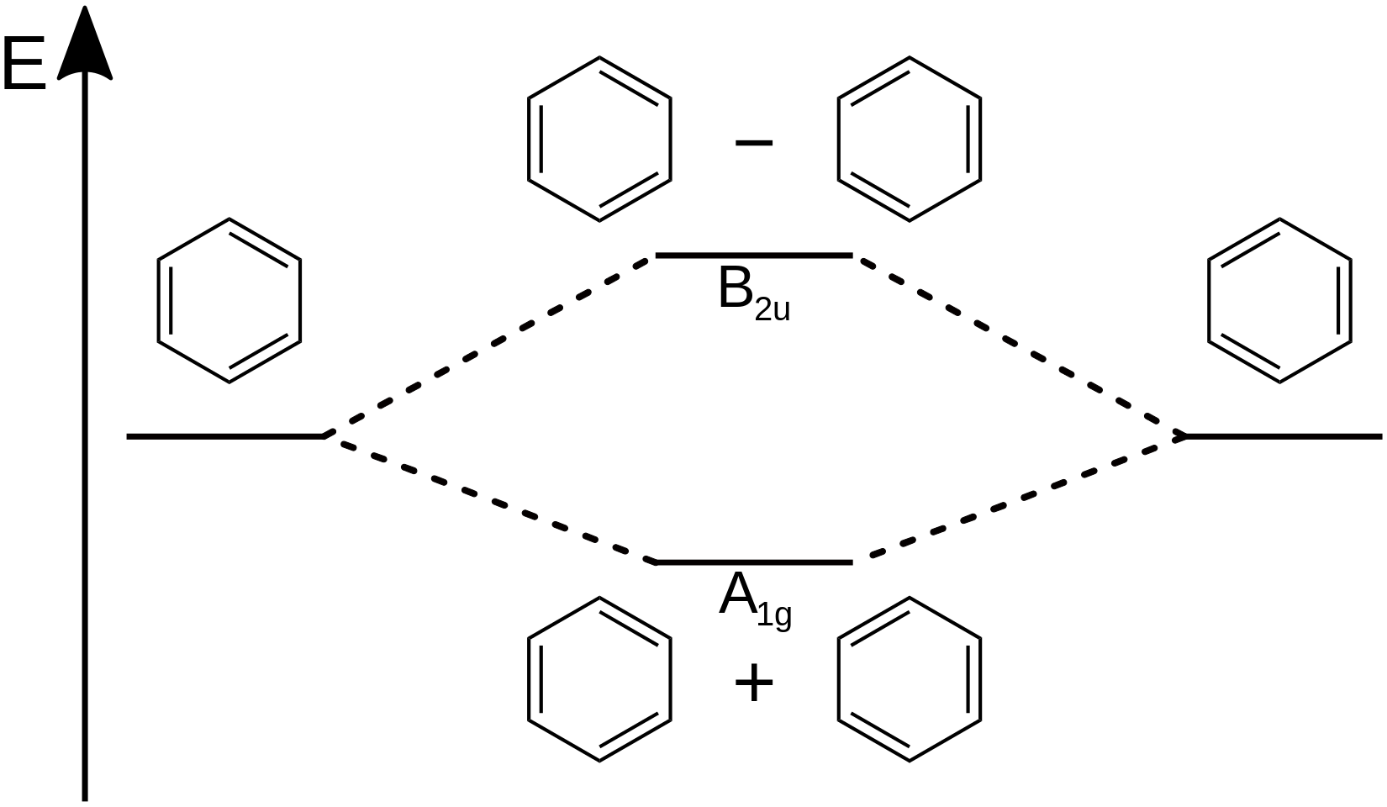
Molecular Orbital Theory
VB versus MO
MO and Quantum Combination
Quantum wave function
Image sourced from Wikimedia Commons

Slide 4



Euler Equation Solution
The first thing that was done was apply the Euler Equation to the given equation of the system:
This yielded a pair of equations that were very similar to a previous problem in which nuclear decay was modelled and one nuclei decayed into another. In this particular instance, the two molecules could "decay" into each other. Thus, the code was largely recycled to yield:
Where NPop is the new population, and CPop is the previous population. Population A is the nuclei being calculated, while Population B is the other potential nuclei. This function was done iteratively over a period of time, and graphed.

Slide 5
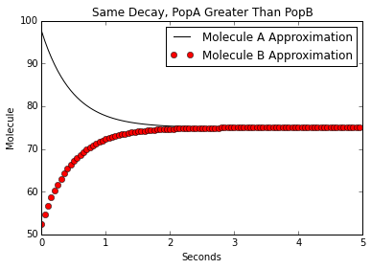
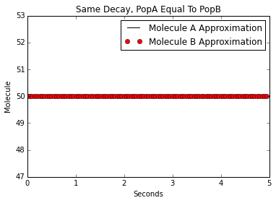
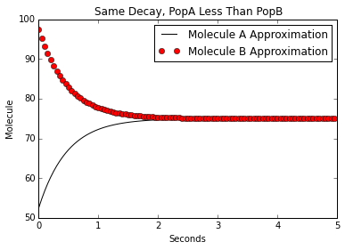
Models Using Equal Decay
By testing a variety of combinations of factors, I was able to produce a few different graphs, with some clear trends. In this instance, I tested a situation in which the decays were equal, but with varying initial populations.

Slide 6
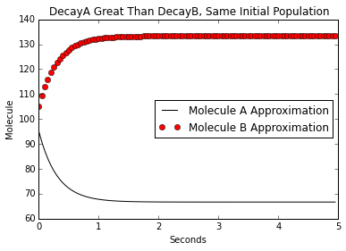
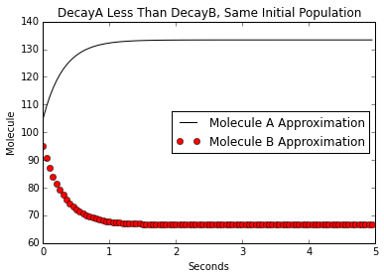
Models Using Equal Population
Then, I began testing what happened when they had the same initial population, and with different decays.

Slide 7
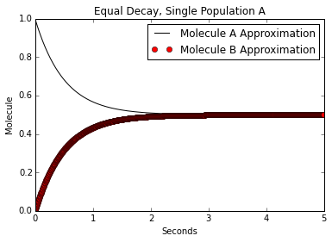
Single Molecule Model
For comparison purposes, I also tested what happened when both populations had the same decay rate, but one population had only a single molecule, while the other had none.
Notably, the result the two settle to is 0.5, which is not an observable result. Instead, it is similar to the splitting of light into orthogonal bases. The average is zero, but one will only observe +1 or -1 counts.

Slide 8
Analysis of the Models
Molecular Properties and Modelling
Order or preference non-present
Weighting given by “decays”
Applying to MO
Pi(π) bonds
Quantum Wave Equation

Slide 9
Results of Models
What was asked?
How can hybrids be represented?
How do hybrid structures play into it?
What was found?
Wave function behaviour (populations, weightings)
Hybridization of Quantum Physics and Chemistry

Slide 10
References
Elements of the Theory of Resonance, E.W. Brown, At The University Press, Osmania University
A Chemist's Guide to Valence Bond Theory, Sason S. Shaik, Philippe C. Hiberty, Wiley-Interscience pg. 200-203

